Slide 1






A few ML algorithms worth further development
Włodzisław Duch
Laboratorium Neurokognitywne,
Interdyscyplinarne Centrum Nowoczesnych Technologii UMK
Katedra Informatyki Stosowanej UMK
Google: W. Duch
Systemy inteligentne. teoria, praktyka, wyzwania, WMNI PW 21/11/2017

Slide 2
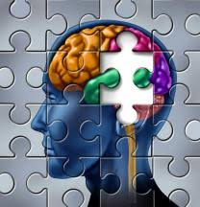
NeuroCog projects
Neurocognitive Informatics: understanding complex
cognition => creating algorithms that work in similar way.
Computational creativity, insight, intuition, imagery.
Imagery agnosia, amusia, musical talent.
Neurocognitive approach to language, word games.
Brain stem models & consciousness in artificial systems.
Medical information retrieval, analysis, visualization.
Comprehensive theory of autism, ADHD, phenomics, education.
Understanding neurodynamics, EEG signals, neurofeedback.
Geometric theory of brain-mind processes.
Infants: observation, perception/WM development.
Neural determinism, free will & social consequences.

Slide 3
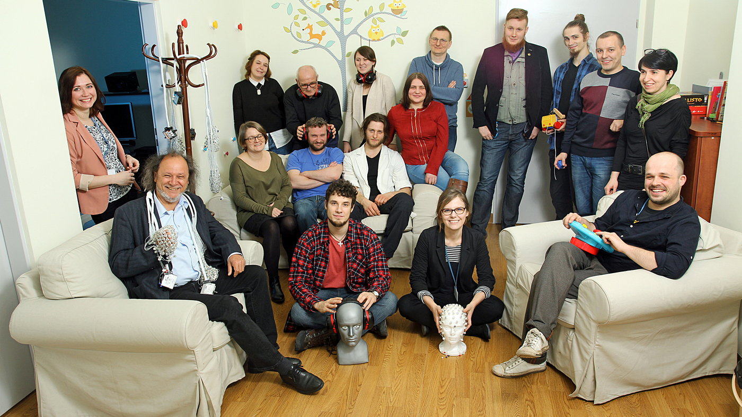
My group of neuro-cog-fanatics

Slide 4
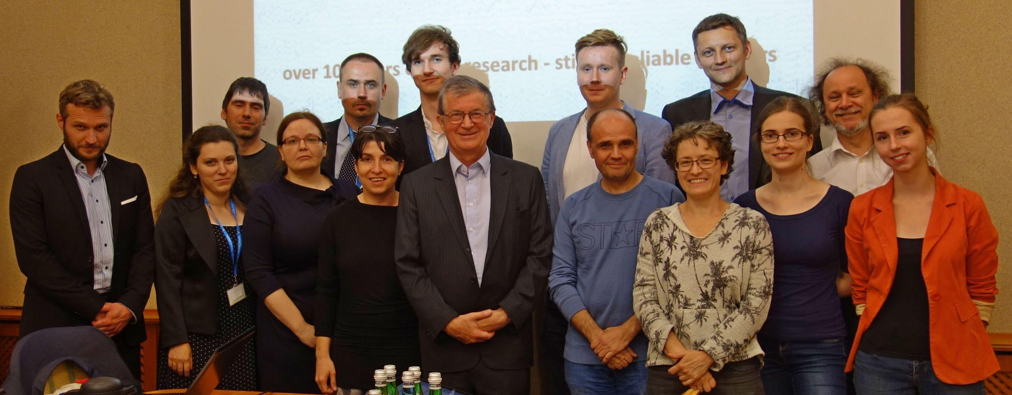




In search of the sources
of brain's cognitive activity
Project „Symfonia”, NCN, Kraków, 18 July 2016
Notes:
4

Slide 5
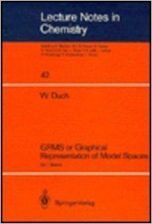
Computational QM
Graphical representation of model spaces. Vol. I Basics.
Springer Verlag, Berlin Lecture Notes in Chemistry
Vol. 42 (1986); Vol. II has never been written …
Idea:
Differential equations, such as Schrodinger equations in quantum mechanics are approximated by algebraic equations defined in tensor spaces with proper symmetry.
In finite dimensional N-particle Hilbert spaces eigenfunctions Ψ become linear combinations a large number of basis functions:
SGGA, Symmetric Group Graphical Approach; Lie algebra, Graphs.

Slide 6
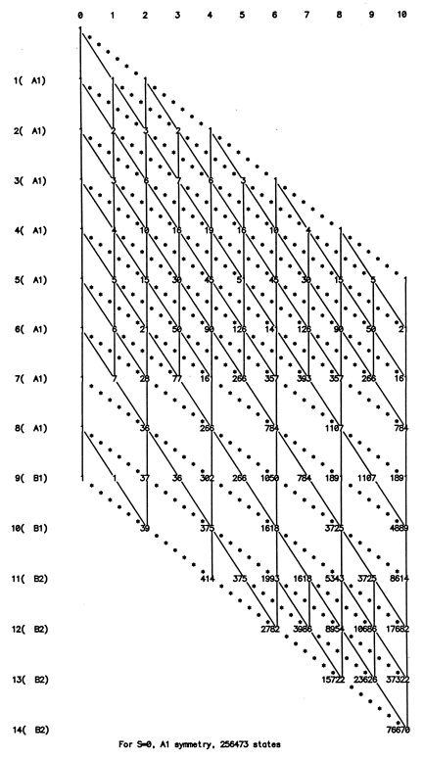
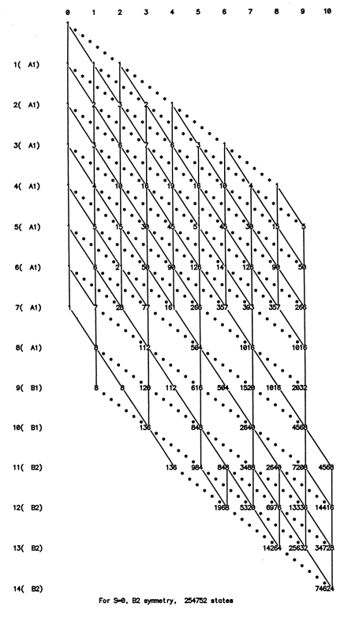
Analyze graph to solve HC=EC

Slide 7
Discovering the wheel
1990-95 - before the Internet and repositories of papers …
RBF discovery:
Broomhead & Lowe (1988), Multivariable functional interpolation and adaptive networks. Complex Systems 2: 321–355.
Duch W (1994) Floating Gaussian Mapping: a new model of adaptive systems. Neural Network World 4:645-654
MDS: Torgerson (1958), Sammon 1969.
Duch W (1995) Quantitative measures for the self-organized topographical mapping. Open Systems and Information Dynamics 2:295-302 (a set of 3rd order equation instead of minimization).

Slide 8
Discovering the wheel - reverse
Although we have Internet some people have yet to rediscover my ideas …
Duch W (1996) Computational physics of the mind. Computer Physics Communication 97: 136-15
Perlovsky, L. I. (2016). Physics of the Mind. Frontiers in Systems Neuroscience, 10. fnsys.2016.00084
Duch W, Diercksen GHF (1995) Feature Space Mapping as a universal adaptive system. Computer Physics Comm. 87: 341-371
Perlovsky LI. Neural networks and intellect: Using model based concepts. New York: Oxford University Press; 2001.
Same with meta-learning, prototype-based learning, transfer functions, creativity and intuition, and a few other ideas.
Creativity, Intuition, Emotions and Perceptual Learning. School of Humanities and Social Sciences, NTU, Singapore, 2005
Cognitive informatics: HITs, DREAMs & Perfect Babies. A*STAR Cognitive Science Symposium, Singapore, September 26, 2005

Slide 9
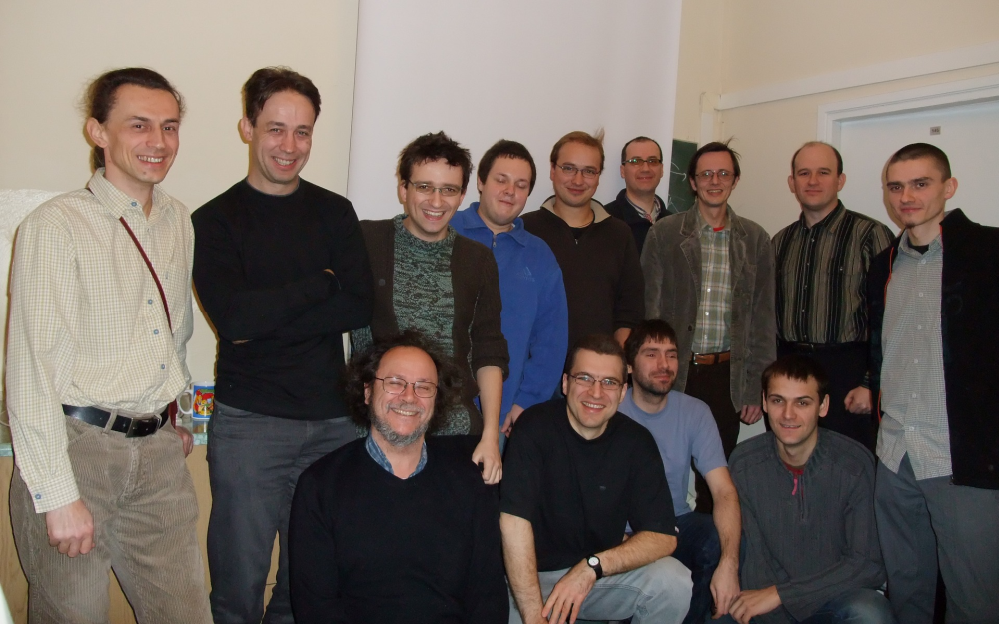
Department of Informatics in 2008

Slide 10
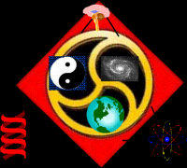
CI Projects
Google W. Duch => List of projects, talks, papers
Computational intelligence (CI), main themes:
Understanding of data: visualization, prototype-based rules.
Foundations of computational intelligence: transformation based learning, k-separability, learning hard boole’an problems.
Novel learning: projection pursuit networks, QPC (Quality of Projected Clusters), search-based neural training, transfer learning or learning from others (ULM), aRPM, SFM ...
Similarity based framework for metalearning, heterogeneous systems, new transfer functions for neural networks.
Feature selection, extraction, creation of enhanced spaces.
General meta-learning, or learning how to learn, deep learning.

Slide 11
CI topics
Understanding NN functions
  Visualization of network functions
  Feature Space Mapping (FSM)
  Prototype-rules (P-rules) and Fuzzy rules (F-rules)
NN learning algorithms
  Support Vector Neural Training (SVNT)
  Almost Random Projection Method (aRPM)
Foundations of CI
  K-representability and complex logic
  Quality of Projected Clusters (QPC)
  Transformation-based learning, heterogeneous systems
  Support Feature Machines (SFM) and Universal Learning Machines (ULM)
Meta-learning
  Framework for Similarity-Based Learning (SBM)
  Real Meta-Learning

Slide 12
Understanding NN functions

Slide 13
Visualization of NN mappings
Problem: NN are black boxes, dangerous to use. Can we trust NN solutions?
Partial solution: visualize error surfaces;
visualize activity of hidden/output neurons on known data+add some noise to investigate stability of NN mapping, convergence, compare different solutions, effects of regularization, type of functions/networks.
Visualization of multi-dimensional trajectories in weight space on error surfaces.
Kordos, M., & Duch, W. (2005). A survey of factors influencing MLP error surface. Control and Cybernetics 33(4), 611–631.
Hidden secrets of neural networks. ICAISC Zakopane, Poland, June 2004
Duch W, Visualization of hidden node activity in neural networks:
I & II. Visualization methods. LN in AI 3070 (2004) 38-43; 44-49
Duch W, Internal representations of multi-layered perceptrons.
Issues in Intelligent Systems: Paradigms. 2005, pp. 49-62.

Slide 14
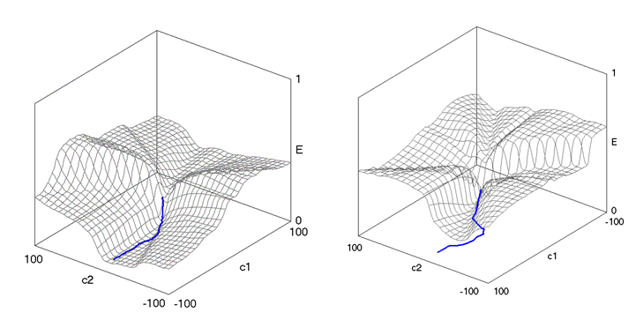
Trajectories of MLP weights
Take weights W_{i} from iterations i=1..K; do PCA on W_{i} covariance matrix. Captures 95-95% variance of the training data with just two vectors. Error functions in 2D PCA shows realistic learning trajectories!
M. Kordos
& W. Duch (2005)
No local minima found. Many large flat plains and valleys.
Many initializations followed by short runs will find good solution.
Data far from decision borders has almost no influence, the main reduction of MSE is achieved by increasing ||W||, sharpening sigmoidal functions.

Slide 15
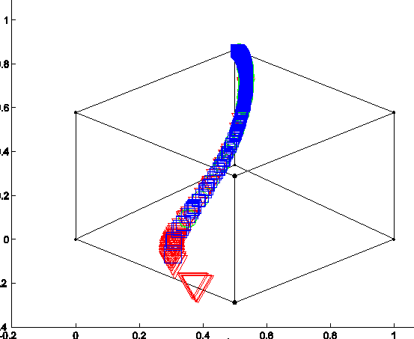
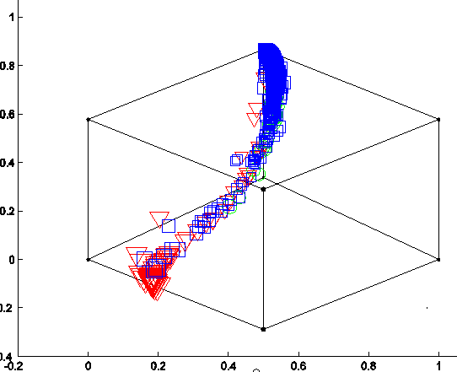
Dynamics of learning
Output images of the training data vectors mapped by NN:
Left: hypothyroid with 3 neurons the network will always under-fit the data, unable to separate small classes.
Right: even if 6 hidden neurons are used problems with convergence may arise in some runs.
Stop further learning, start from another initialization.

Slide 16
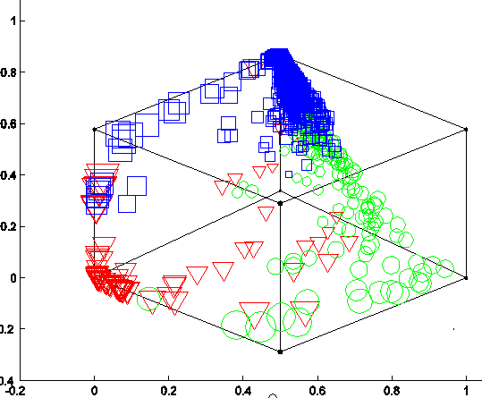
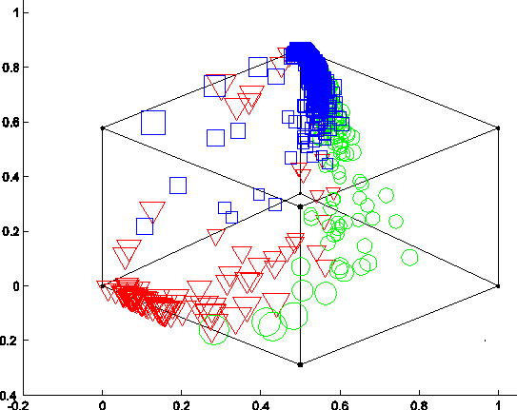
Promising convergence
SCG training, network structure 21-8-3.
Output vectors displayed. Ideal results: (1,0,0), or (0,1,0) or (0,0,1).
Two runs, intermediate solutions after 100 iterations,
left 164 right 197 errors.

Slide 17
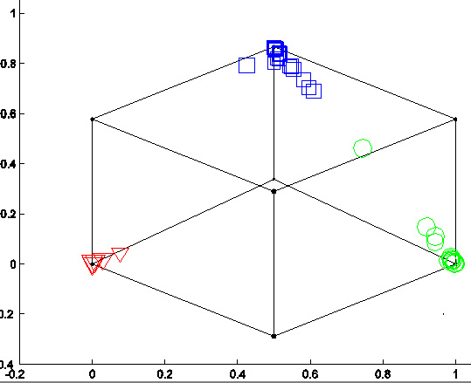
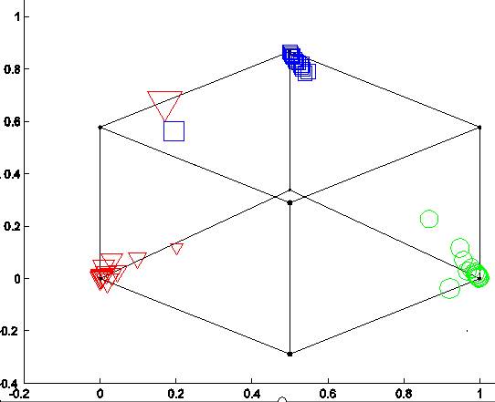
Converged ...
Two very good converged solutions after 19 K and 22 K iterations, SCG training, 21-8-3, both cases 1 error, ~ same MSE.
Left: green–blue potential mixing; right: blue–red classes mixing. Networks are over-confident and not stable, weights are very large, sigmoids are step-like, decision borders are very sharp,
most training vectors are mapped to a single point, output is (1,0,0) etc.
New data near decision boundaries may fall on a wrong side.

Slide 18
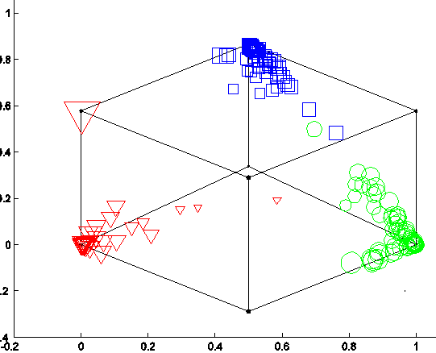
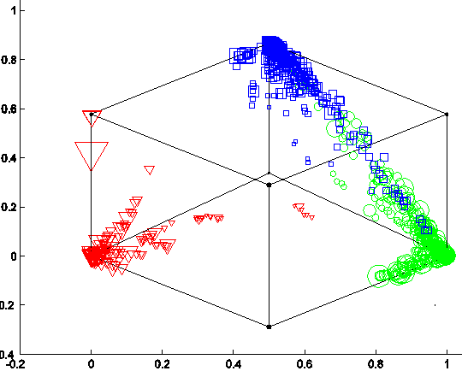
Adding regularization
Regularization expands output clusters, but solution is more smooth and stable; below α=0.01 regularization is used.
Left: solution with 12 hidden neurons, 2 errors;
Right: small variance (0.001) noise perturbation, 5 additional vectors per one training vector added => many errors appear.
Still regularization is too small.

Slide 19
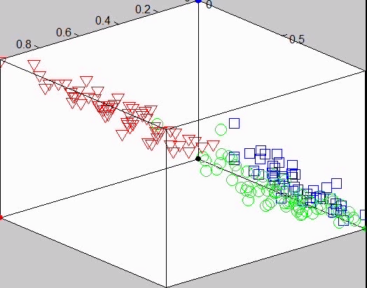
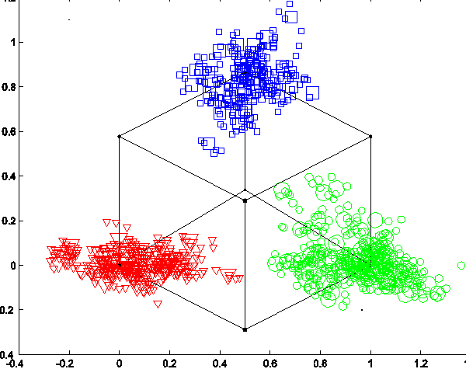
MLP/RBF Wine solution
Wine data, 8-2-3 MLP and 8-6-3 RBF networks.
Perfect solutions may be dangerous! Add some noise to inputs to check for overfitting and see classification margins.
RBF always provides soft decision borders, not 0-1 outputs, but still separable clusters, more stable when small perturbations are added.

Slide 20
What is inside?
Many types of internal representations may look identical
from outside, but generalization may depend on them.
Classify different types of internal representations.
Take permutational invariance into account: equivalent internal representations may be obtained by re-numbering hidden nodes.
Good internal representations should form compact clusters in the internal space.
Check if the representations form separable clusters.
Discover poor representations and stop training.
Analyze adaptive capacity of networks.
.....

Slide 21
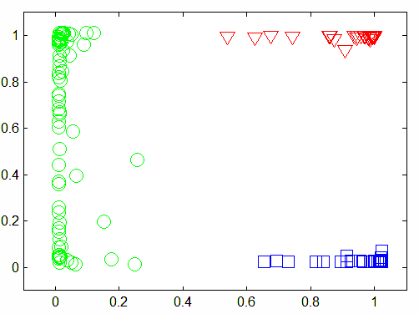
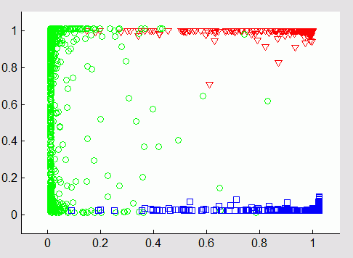
Wine: hidden 2D
Many solutions in 2D hidden space: which is the best?
Add noise to input data to see how stable the solution is.
Here each X => 10 points X+Gaussian noise with 0.05 variance.
Analysis n higher dimensions done using parallel coordinates, projections to polyhedra, FSD, SNE and other techniques.

Slide 22
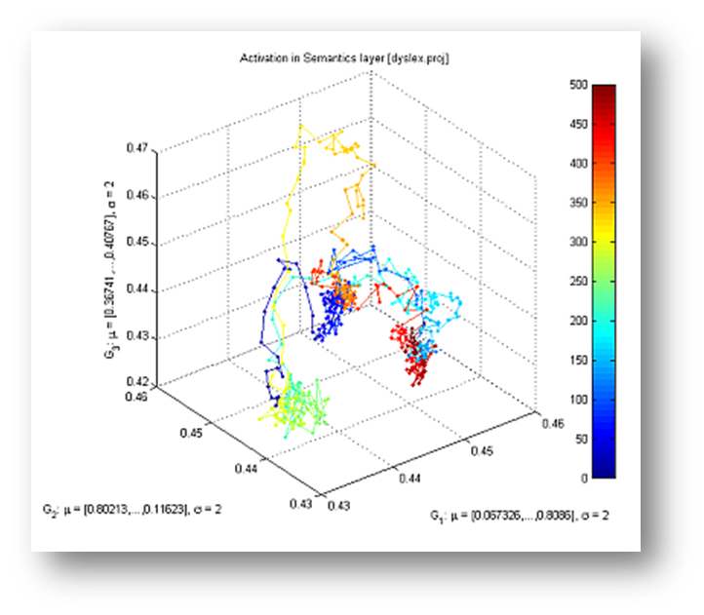
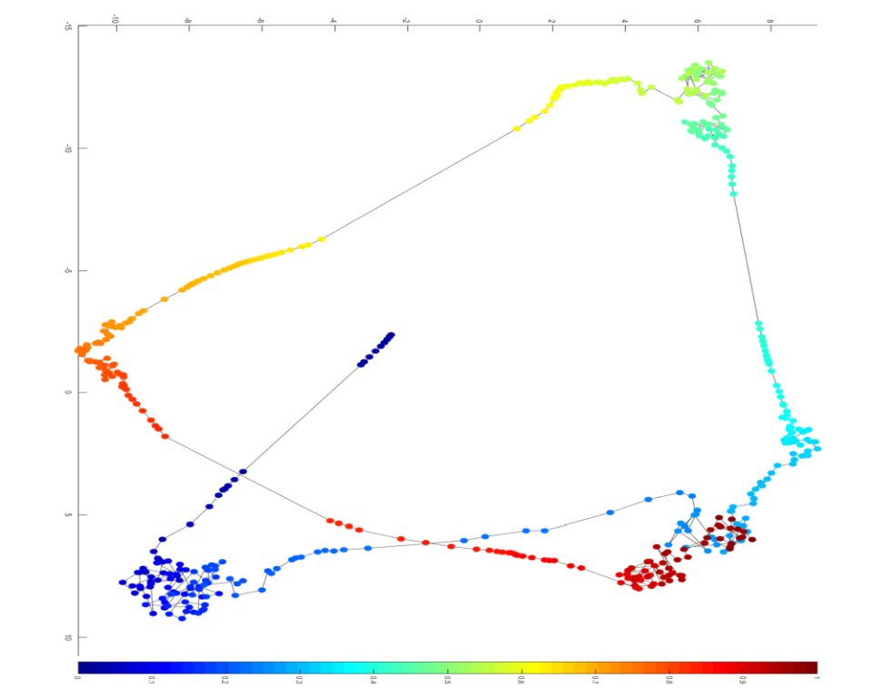
Hi-D trajectories
140 active units (dyslexia model in Emergent neural simulator);
noisy attractor dynamics, FSD and SNE trajectories with 500 points.
Thanks to K. Dobosz Viser toolbox, and M. Orliński SNE implementation.

Slide 23
What feedforward NN really do?
Vector mappings from the input space to hidden space(s), and finally to the output space where data should be separable.
Hidden-Output mapping done usually by perceptrons.
A single hidden layer case is analyzed below.
T = {X^{i}} training data, N-dimensional.
H = {h_{j}(X^{i})} T image in the hidden space, j =1 .. N_{H}-dim.
Y = {y_{k}{h(X^{i})} T image in the output space, k =1 .. N_{C}-dim.
NN goal: scatterograms of H, the image of T in the hidden space should be linearly separable; internal representations will determine network generalization capabilities and other properties.
Is this a good goal? Can it be easily achieved?
“Universal approximator” theorem is not helpful.

Slide 24
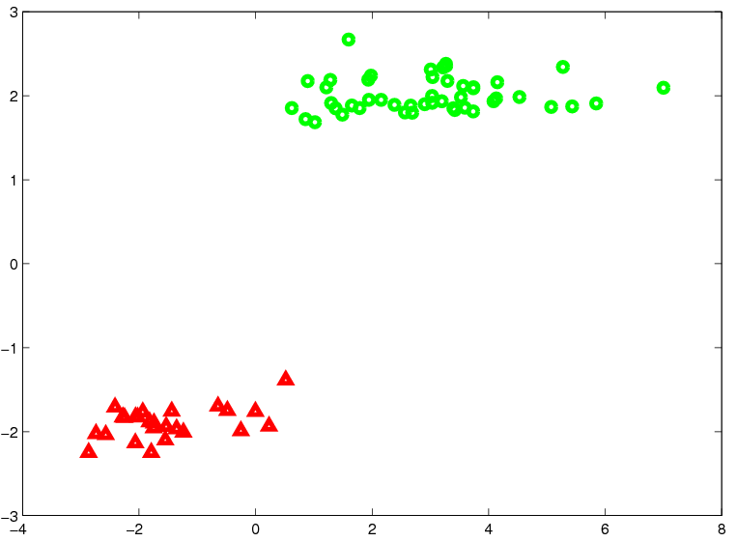
Linear separability
SVM visualization of Leukemia microarray data,
Horizontal axis x=WX, vertical - orthogonal projection.

Slide 25
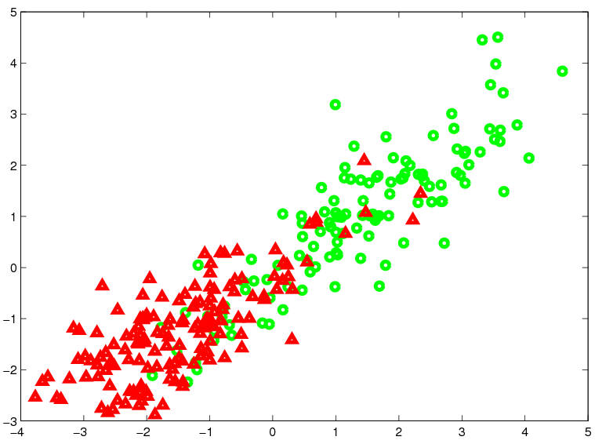
Approximate separability
SVM visualization of Heart dataset, overlapping clusters, information in the data is insufficient for perfect classification.

Slide 26
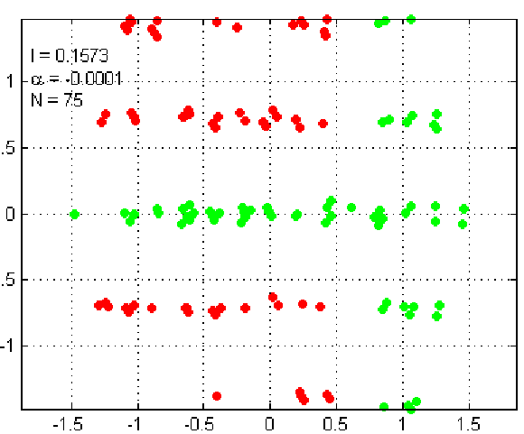
Rules
QPC visualization of Monks dataset with simple logical structure,
two logical rules are needed, or combination of two projections.

Slide 27
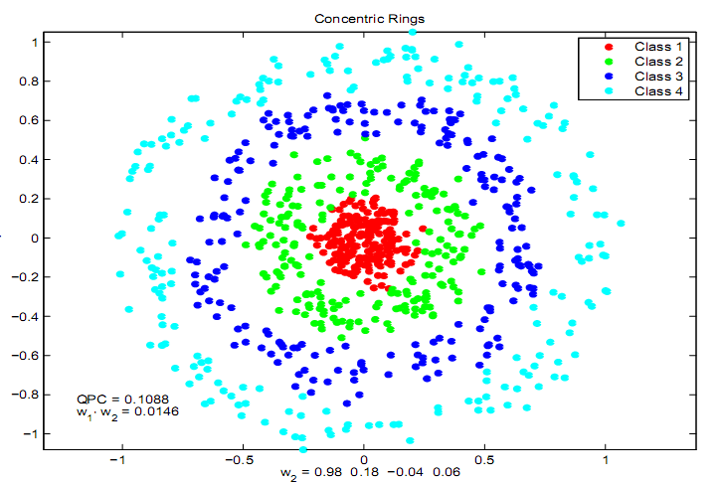
Complex distribution
QPC visualization of concentric rings in 2D with strong noise in remaining 2D; transform: nearest neighbor solutions, combinations of ellipsoidal densities.

Slide 28
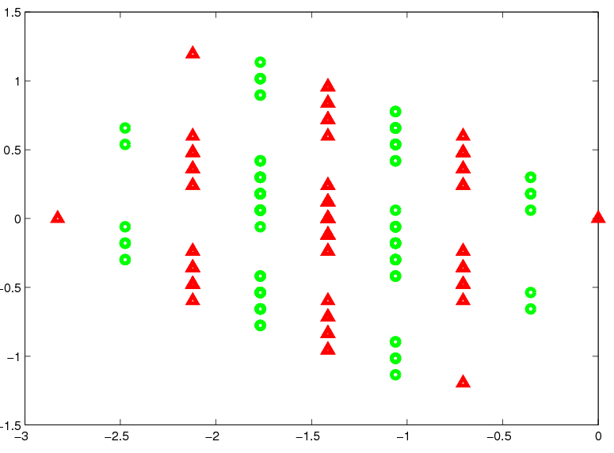
Interval transformation
8-bit parity data: 9-separability is much easier to achieve than full
linear separability.

Slide 29
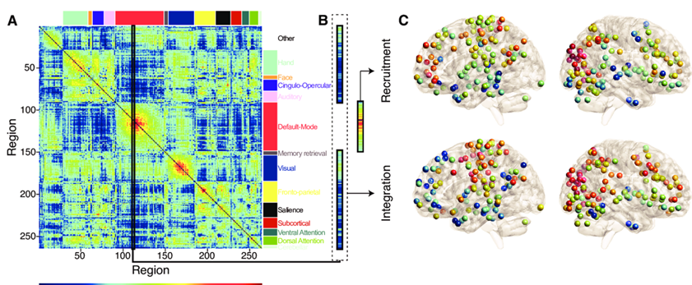
Much more complex logic …
Different activations => same cognitive functions in different context? Complex logic may be needed to learn from this type of data.
Mattar, M. G., Cole, M. W., Thompson-Schill, S. L., & Bassett, D. S. (2015).
A Functional Cartography of Cognitive Systems.
PLOS Computational Biology, 11(12), e1004533.
Notes:
Mattar, M. G., Cole, M. W., Thompson-Schill, S. L., & Bassett, D. S. (2015). A Functional Cartography of Cognitive Systems. PLOS Computational Biology, 11(12), e1004533.

Slide 30
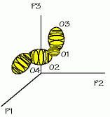
FSM - neurofuzzy systems
Feature Space Mapping (FSM) constructive neurofuzzy system. Neural adaptation, estimation of probability density distribution (PDF) using single hidden layer network (RBF-like), with nodes realizing separable basis functions (SBF networks):
Model of mental processes–FSM nodes representing attractors, mental events.
Duch W, Diercksen GHF (1995) Feature Space Mapping as a universal adaptive system. Computer Physics Communications 87: 341-371
Duch W (1997) Platonic model of mind as an approximation to neurodynamics. In: Brain-like computing and intelligent information systems, ed. S-i. Amari, N. Kasabov (Springer, Singapore 1997), chap. 20

Slide 31
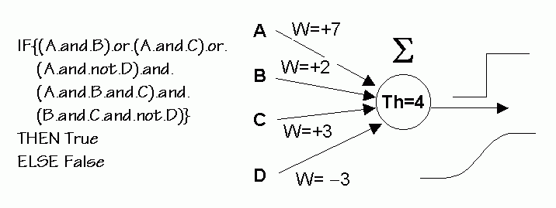
Rules from MLPs
Why is it difficult?
Multi-layer perceptron (MLP) networks: stack many perceptron units, performing threshold logic:
M-of-N rule: IF (M conditions of N are true) THEN ...
Problem: for N inputs number of subsets is 2^{N}.
Exponentially growing number of possible conjunctive rules.

Slide 32
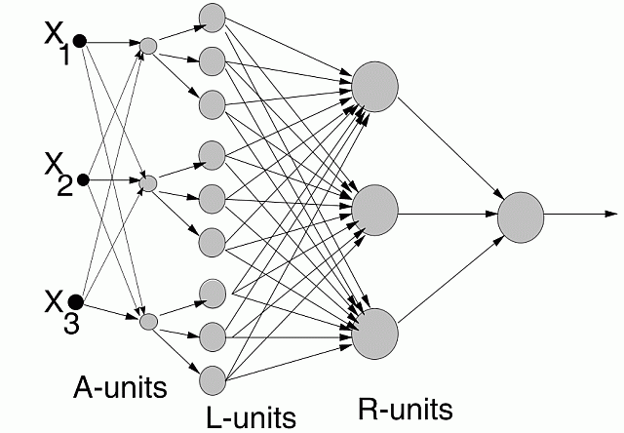
MLP2LN
Converts MLP neural networks into a network performing logical operations (LN).
Input
layer
Output: one node per class.
Aggregation:
better features
Linguistic units: windows, filters
Rule units: threshold logic

Slide 33
Prototype-based rules
C-rules (Crisp), are a special case of F-rules (fuzzy rules).
F-rules (fuzzy rules) are a special case of P-rules (Prototype)!
P-rules have the form:
IF P = arg min_{R} D(X,R) THAN Class(X)=Class(P)
D(X,R) = dissimilarity (distance) function, determining local decision borders.
P-rules are easy to interpret and offer better description than F-rules!
IF X=You are most similar to the P=Superman
THAN You are in the Super-league.
“Similar” may involve different features or D(X,P). What is similar for the brain?
Kernel features in SVM are particular example of similarity functions.
Duch W, Setiono R, Zurada J.M, Computational intelligence methods for understanding of data. Proc. of the IEEE 92(5) (2004) 771- 805
Duch W, Adamczak R, Grąbczewski K, A new methodology of extraction, optimization and application of crisp and fuzzy logical rules. IEEE Transactions on Neural Networks 12 (2001) 277-306

Slide 34
P-rules
Euclidean distance leads to a Gaussian fuzzy membership functions + product as T-norm. In this case FSM = RBF.
Manhattan function => μ(X;P)=exp{−|X-P|}
Various distance functions lead to different MF.
Ex. data-dependent probabilistic distance functions for symbolic data:

Slide 35
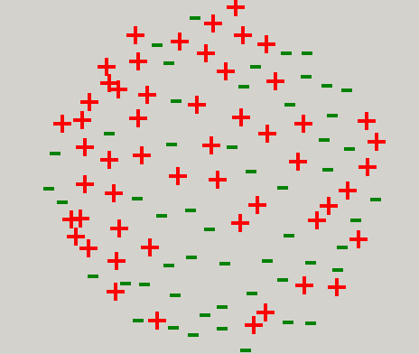
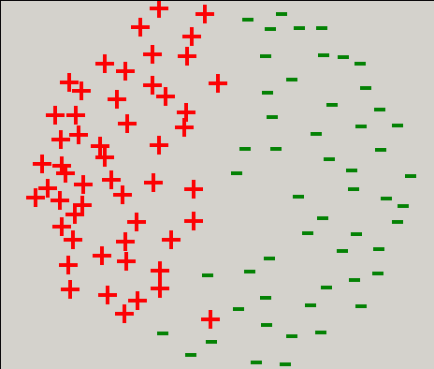
Promoters with p-distances
DNA strings, 57 aminoacids, 53 + and 53 - samples
tactagcaatacgcttgcgttcggtggttaagtatgtataatgcgcgggcttgtcgt
Euclidean distance, symbolic
s =a, c, t, g replaced by x=1, 2, 3, 4
PDF distance, symbolic
s=a, c, t, g replaced by p(s|+)

Slide 36
P-rules and C-rules
New distance functions from info theory => interesting MF.
MF => new distance function, with local similarity D(X,R) for each cluster.
Crisp logic rules: use Chebyshev distance (L∞ norm):
D_{Ch}(X,P) = ||X−P||∞ = max_{i} W_{i} |X_{i}−P_{i}|
D_{Ch}(X,P) = const => rectangular contours.
Chebyshev distance with thresholds θ_{P}
IF D_{Ch}(X,P) ≤ θ_{P} THEN C(X)=C(P)
is equivalent to a conjunctive crisp rule
IF X₁∈[P₁−θ_{P}/W₁,P₁+θ_{P}/W₁] ∧…X_{N} ∈[P_{N} −θ_{P}/W_{N},P_{N}+θ_{P}/W_{N}]
THEN C(X)=C(P)

Slide 37
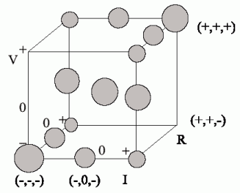
P-rules and intuitive thinking
Question in qualitative physics (PDP book):
if R₂ increases, R₁ and V_{t} are constant, what will happen with current and V₁, V₂ ?
Learning from partial observations:
Ohm’s law V=I×R; Kirhoff’s V=V₁+V₂.
Geometric representation of qualitative facts:
+ increasing, 0 constant, - decreasing.
True (I₋,V₋,R₀), (I₊,V₊,R₀), false (I₊,V₋,R₀).
5 laws: 3 Ohm’s 2 Kirhoff’s laws.
All laws A=B+C, A=B×C , A⁻¹=B⁻¹+C⁻¹, have identical geometric interpretation!
13 true, 14 false facts; simple P-space, but complex neurodynamics.

Slide 38
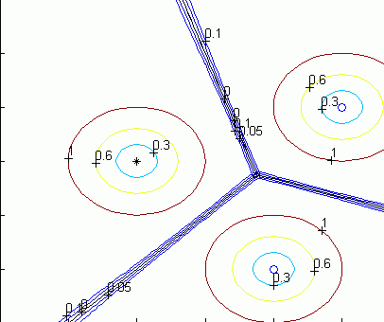
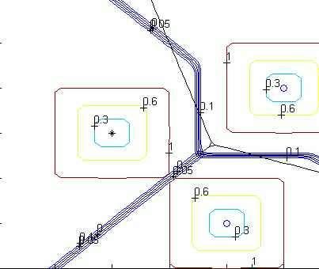
Decision borders
D(P,X)=const and decision borders D(P,X)=D(Q,X).
Euclidean distance from 3 prototypes, one per class.
Minkovski α=20 distance from 3 prototypes.

Slide 39
NN learning algorithms

Slide 40
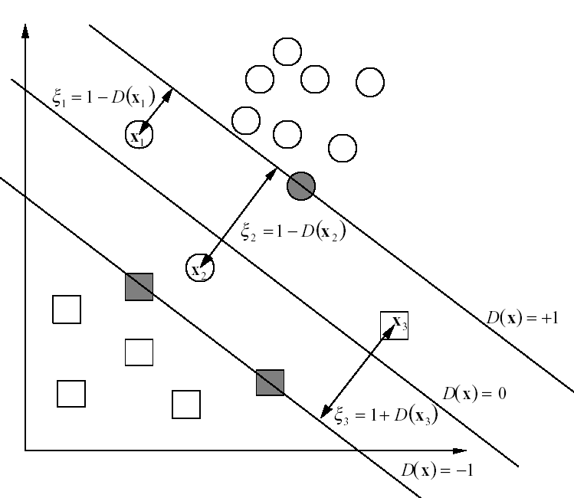
Support Vectors
SVM gradually focuses on the training vectors near the decision hyperplane – can we do the same with MLP?

Slide 41
Selecting Support Vectors
Active learning: if contribution to the parameter change is negligible remove the vector from training set.
If the difference
is sufficiently small the pattern X will have negligible influence on the training process and may be removed from the training.
Conclusion: select vectors with ε_{W}(X)>ε_{min}, for training.
2 problems: possible oscillations, and strong influence of outliers.
Solution: adjust ε_{min} dynamically to avoid oscillations;
remove also vectors with ε_{W}(X) > 1−ε_{min} = ε_{max}

Slide 42
SVNT algorithm (2005)
Initialize the network parameters W,
set Δε=0.01, ε_{min}=0, set SV=T.
Until no improvement is found in the last N_{last} iterations do
Optimize network parameters for N_{opt} steps on SV data.
Run feedforward step on T to determine overall accuracy and errors, take SV={X|ε(X)∈ [ε_{min},1−ε_{min}]}.
If the accuracy increases:
compare current network with the previous best one, choose the better one as the current best
increase ε_{min}=ε_{min}+Δε and make forward step selecting SVs
If the number of support vectors |SV| increases:
decrease ε_{min}=ε_{min}−Δε;
decrease Δε = Δε/1.2 to avoid large changes
Notes:
Duch W, Support Vector Neural Training. Lecture Notes in Computer Science, Vol 3697, 67-72, 2005

Slide 43
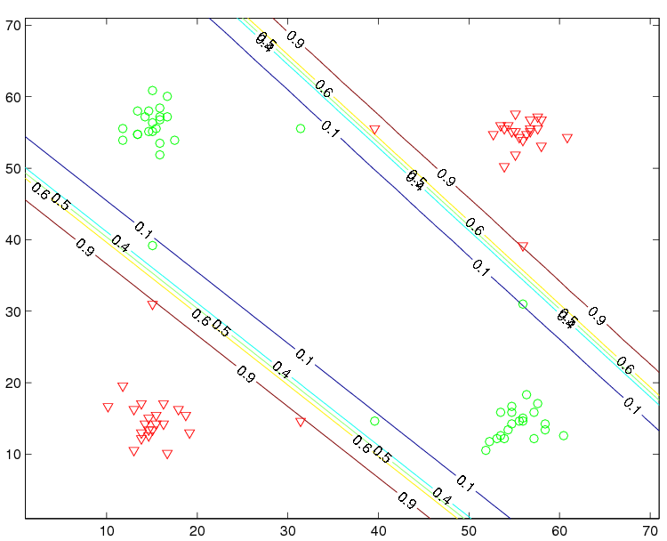
XOR solution

Slide 44
Hypothyroid data example
2 years real medical screening tests for thyroid diseases, 3772 cases with 93 primary hypothyroid and 191 compensated hypothyroid, the remaining 3488 cases are healthy; 3428 test, similar class distribution.
21 attributes (15 binary, 6 continuous), but only 2 binary attributes (on thyroxine, and thyroid surgery) are useful, therefore 8 attributes are used.
Method % train % test
C-MLP2LN rules 99.89 99.36
MLP+SCG, 4 neurons 99.81 99.24
SVM Minkovsky opt kernel 100.0 99.18
MLP+SCG, 4 neur, 67 SV 99.95 99.0
MLP+SCG, 12 neur. 100.0 98.8
Cascade correlation 100.0 98.5
MLP+backprop 99.60 98.5
SVM Gaussian kernel 99.76 98.4

Slide 45
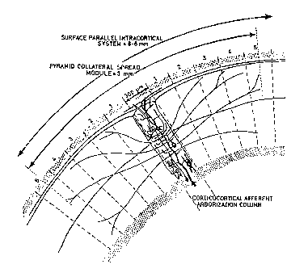
Biological inspirations
Cortical columns may learn to respond to stimuli with complex logic, resonating in different way.
Liquid state machine (LSM; Maas, Markram 2004) – large spiking recurrent neural network, randomly connected.
S(t) => LSM (x,t), spatio-temporal pattern of activations, creating separable high dimensional projections, perceptrons can handle that.
Simplifications for static data:
1) Oscillators based on combination of two neurons σ(W.X-b) – σ(W.X-b’)
give localized projections ⬄ specific resonant states!
Used in MLP2LN architecture for extraction of logical rules from data.
2) Single hidden layer constructive network based on random projections.

Slide 46
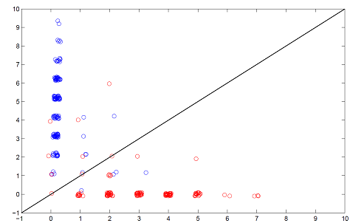
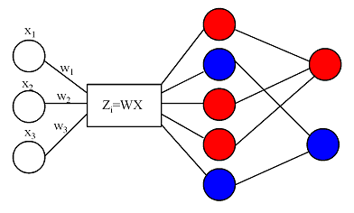
aRPM
aRMP, Almost Random Projection Machine (with Hebbian learning):
generate random combinations of inputs (line projection) z(X)=W.X,
find and isolate pure cluster h(X)=G(z(X)); localized kernel on projections,
estimate relevance of h(X), ex. MI(h(X),C),
leave only good nodes and continue until each vector activates minimum k hidden nodes.
Count how many nodes vote for each class and plot: no LDA needed!
No need for learning at all!

Slide 47
Main idea
Following biological inspirations - aRPM, single hidden layer constructive network based on random projections added only if useful;
easily solve highly-non-separable problems.
Kernel-based features extend the hypothesis space.
Cover theorem guarantees better separability.
Linear kernels define new features t(X;W)=K_{L}(X,W)=X·W based on a projection on the W direction.
Gaussian kernels g(X,W)=exp(-||X-W||/(2σ²)) evaluate similarity between two vectors using weighted radial distance function.
The final discriminant function is constructed as a linear combination of such kernels.
Focus on margin maximization in aRPM; new projections added only if they increase correct classification probability of those examples that are wrongly classified or are close to the decision border.

Slide 48
aRPM
Some projections may not be very useful, but the distribution of the training data along direction may have a range of values that includes a pure cluster of projected patterns.
This creates binary features b_{i}(X) = t(X;W_{i},[t_{a},t_{b}]) ϵ {0,1}, based on linear restricted projection in the direction W.
Good candidate feature should cover some minimal number η of training vectors.
Features based on kernels - here only Gaussian kernels with several values of dispersion σ g(X;X_{i},σ)=exp(-||X_{i}-X||²/2σ²).
Local kernel features have values close to zero except around their support vectors X_{i}.
Their usefulness is limited to the neighborhood O(X_{i}) in which g_{i}(X)>ϵ.

Slide 49
aRPM with margin optimization
In the WTA |A(C|X)-A(¬C|X)| estimates distance from the decision border.
Specifying confidence of the model for vector XϵC using logistic function:
F(X)=1/(1+exp(-(A(C|X)-A(¬C|X))))
gives values around 1 if X is on the correct side and far from the border, and goes to zero if it is on the wrong side.
Total confidence in the model may then be estimated by summing over all vectors.
The final effect of adding new feature h(X) to the total confidence measure is therefore:
U(H,h)=Σ (F(X;H+h) - F(X;H))
If U(H,h)>α than the new feature is accepted providing a larger margin.
To make final decision aRPM with margin maximization uses WTA mechanism or LD.

Slide 50
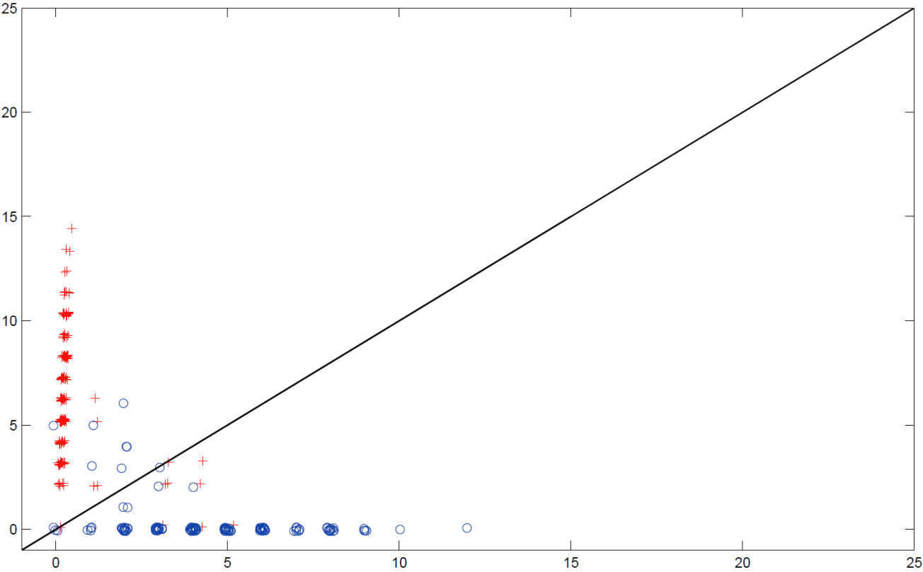
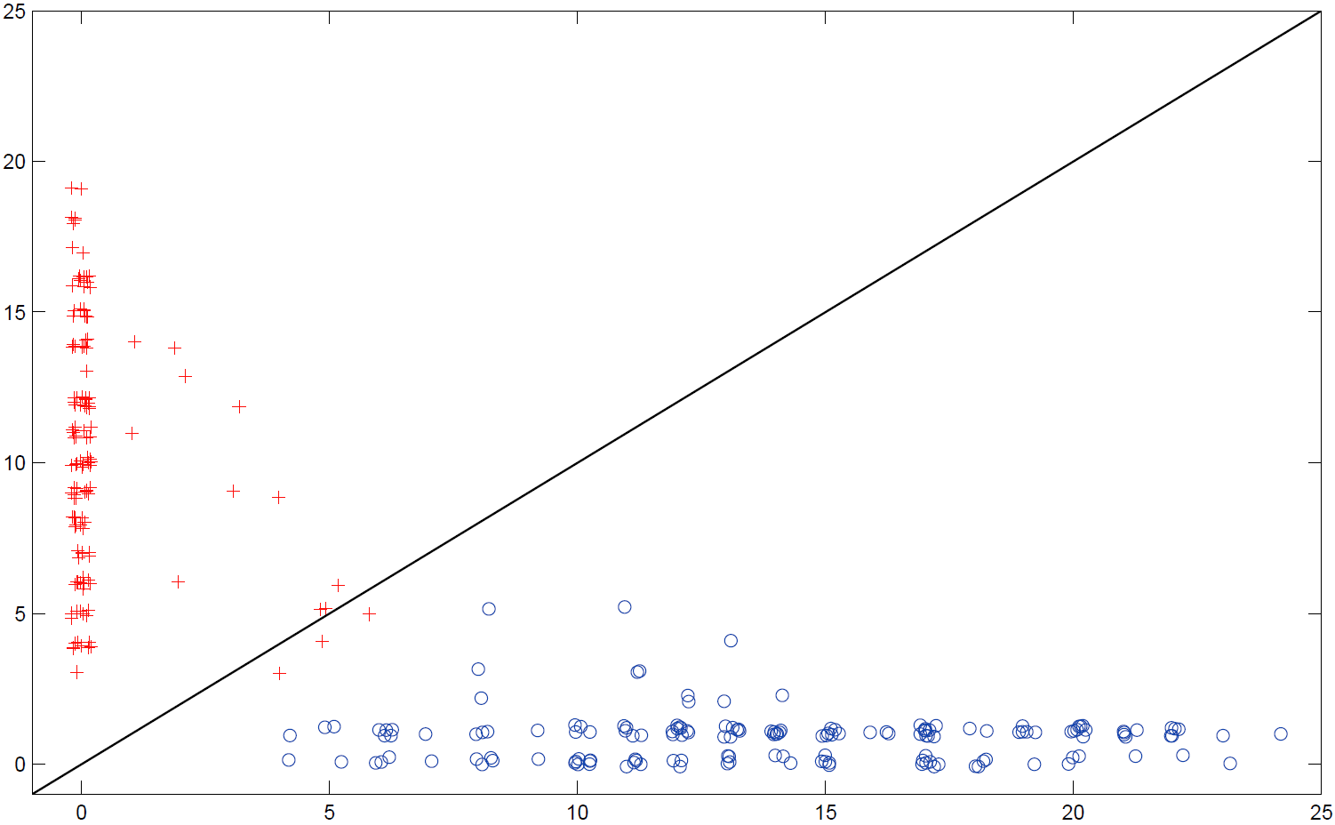
Heart Statlog data
no margin
maximization
Axes: number of voting nodes for each vector; color = class
with margin
maximization
More vectors activate many nodes from correct class, few vectors are close to the decision border (majority voting).

Slide 51
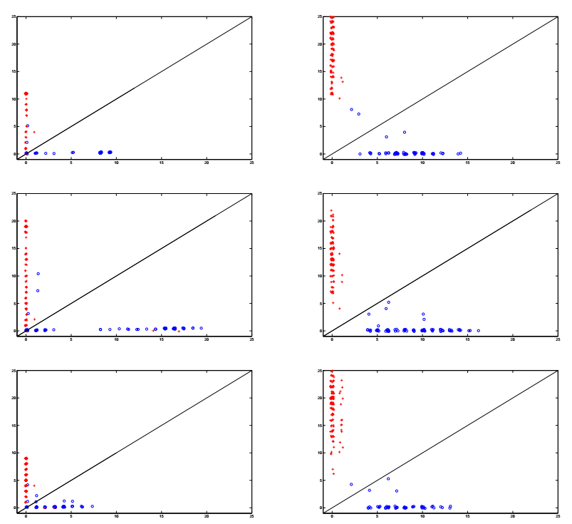
no margin maximization
with margin maximization
Wine data, 3 classes, pairwise

Slide 52
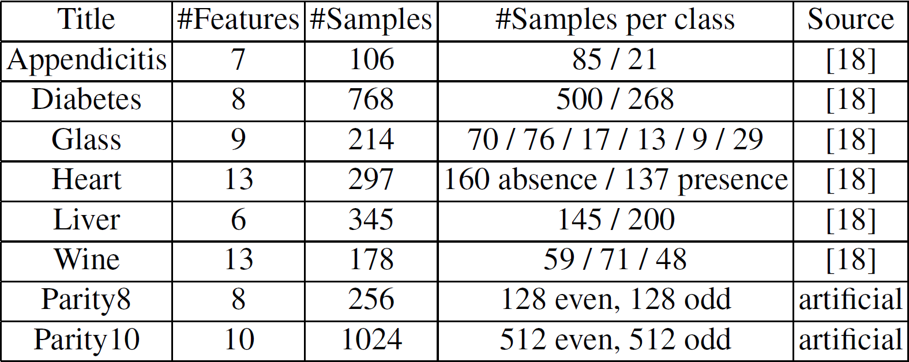
Datasets

Slide 53
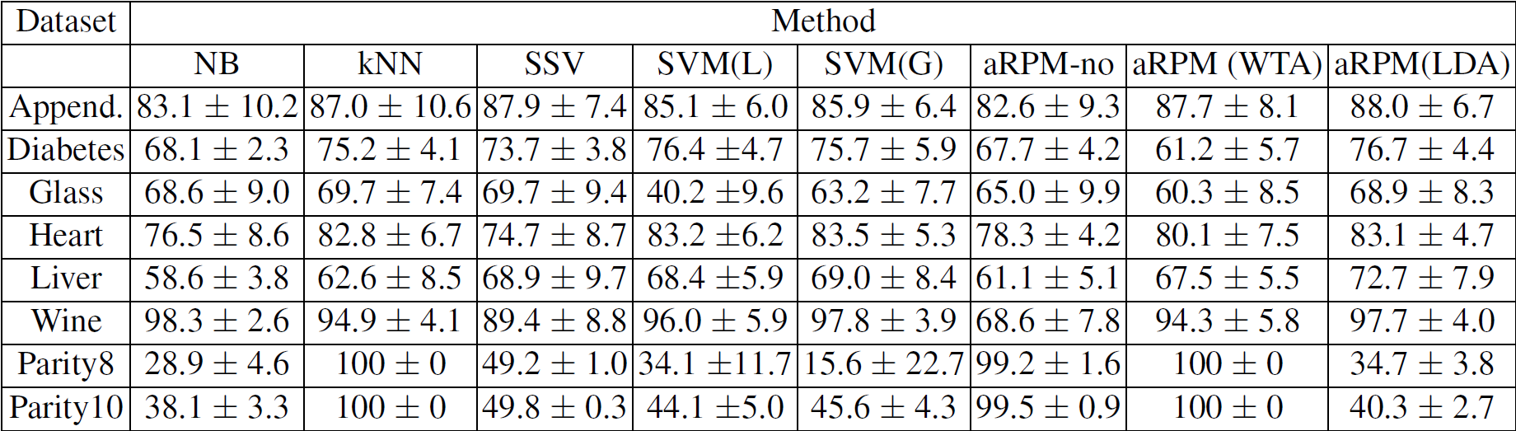
aRMP results
Simplest method that solves highly-non separable problems like parity!

Slide 54
aRPM with locally optimized kernels
To create multi-resolution kernel features – first with large σ (smooth decision borders), then smaller σ (features more localized).
The candidate feature is converted into a permanent node only if it increases classification margin.
Incremental algorithm, expand feature space until no improvements; move vectors away from decision border.
WTA - sum of the activation of hidden nodes. Projections with added intervals give binary activations b_{i}(X), but the values of kernel features g(X;X_{i},σ) are summed, giving a total activation A(C|X) for each class.
Plotting A(C|X) versus A(¬C|X) for each vector leads to scatterograms, giving an idea how far is a given vector from the decision border.

Slide 55
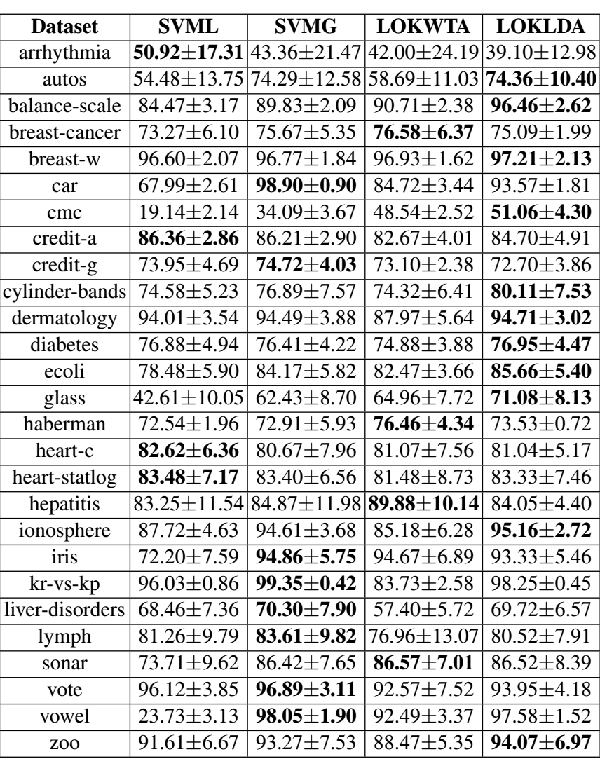
aRMP with
LOK results, simplest version

Slide 56
aRMP conclusions
aRPM has many advantages that has not been yet explored.
Some work on ELM (Extreme Learning Machines) goes in this direction.
Biological plausibility – virtually no learning involved, just generation and selection of features.
Solves fast learning problem. Focus on generation of new features followed by the WTA, simpler and faster than typical NN networks.
Selection of network nodes to ensure wide margins.
Adding kernel features, locally optimized, relations to kernel SVM
Feature selection and construction, finding interesting views on the data is the basis of natural categorization and learning processes.
Scatterograms of WTA output show effects of margin optimization, and allow for estimation of confidence in classification of a given data.
Further improvements: admission of impure clusters instead of binary features, use of other kernel features, locally optimized kernels, selection of candidate SV, optimization of the algorithm.

Slide 57
Foundations of Machine Learning

Slide 58

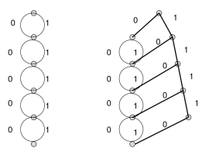
Principles: information compression
Neural information processing in perception and cognition:
information compression, or algorithmic complexity.
In computing: minimum length (message, description) encoding.
Wolff (2006): all cognition and computation is information compression!
Analysis and production of natural language, fuzzy pattern recognition, probabilistic reasoning and unsupervised inductive learning.
Talks about multiple alignment, unification and search, but only models for sequential data and 1D alignment have been demonstrated.
Information compression: encoding new information in terms of old.
Measure of syntactic and semantic information (Duch, Jankowski 1994); based on the size of the minimal graph representing a given data structure or knowledge-base specification, thus it goes beyond alignment;
real information = what model cannot predict.
“Surprise” and curiosity measures: Pfaffelhuber (1972), Palm, Schmidhuber, Baldi … all based on the same idea.

Slide 59
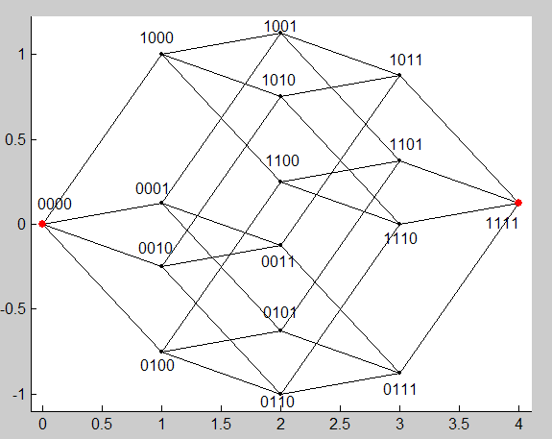
What can be learned?
Linearly separable or almost separable problems are relatively simple – deform planes or add dimensions to make data separable.
How to define “slightly non-separable”, or relatively easy to learn?
Now we have only separable problems and one vast realm of the rest.

Slide 60

Easy problems
Approximately linearly separable problems in the original feature space: linear discrimination is sufficient (always worth trying, but no-one does!).
Simple topological deformation of decision borders is sufficient – linear separation is then possible in extended/transformed spaces.
This is frequently sufficient for pattern recognition problems (more than half of UCI problems).
RBF/MLP networks with one hidden layer also solve such problems easily, but convergence/generalization for anything more complex than XOR is problematic.
SVM adds new features to “flatten” the decision border:
achieving larger margins/separability in the X+Z space.

Slide 61
Neurons learning complex logic
Boole’an functions are difficult to learn, n bits but 2^{n} nodes => combinatorial complexity; similarity is not useful, for parity all neighbors are from the wrong class. MLP networks have difficulty to learn functions that are highly non-separable.
Ex. of 2-4D parity problems.
Neural logic can solve it without counting;
find a good point of view.
Projection on W=(111 ... 111) gives clusters with 0, 1, 2 ... n bits;
solution requires abstract imagination + easy categorization.

Slide 62

Easy and difficult problems
Linear separation: good goal if simple topological
deformation of decision borders is sufficient.
RBF/MLP networks with one hidden layer solve such problems.
Difficult problems: disjoint clusters, combinatorial problems, complex logic.
Networks with localized functions need exponentially large number of nodes.
Q1: How to characterize complexity of Boolean functions? Non-separability is not sufficient.
Q2: What is the simplest model for a given type of data?
Q3: How to learn such model in an automatic way?
Boolean functions: n=2 vectors V={00,01,10,11},
Boolean functions {0000, 0001 ... 1111}, ex. 0001 = AND, 0110 = OR,
each function is identified by number from 0 to 15 = 2^{K}-1.
For n bits there are K=2^{n} binary vectors that can be represented as vertices of n-dimensional hypercube.
Each Boolean function is identified by K bits.
BoolF(B_{i}) = 0 or 1 for i=1..K, leads to the 2^{K} Boolean functions.

Slide 63

Boolean functions
n=2, 16 functions, 12 separable, 4 not separable.
n=3, 256 f, 104 separable (41%), 152 not separable.
n=4, 64K=65536, only 1880 separable (3%)
n=5, 4G, but << 1% separable ... bad news!
Most bioinformatics or neuroimaging data may require n >100.
Existing methods may learn some non-separable functions,
but most functions cannot be learned !
Example: n-bit parity problem; many papers in top journals.
No off-the-shelf systems are able to solve such problems.
For all parity problems SVM is below base rate!
Such problems are solved only by special neural architectures or special classifiers – if the type of function is known.
But parity is still trivial ... solved by

Slide 64

Goal of learning
If simple topological deformation of decision borders is sufficient linear separation is achieved in high dimensional spaces, “flattening” non-linear decision borders; this is frequently the case in pattern recognition problems. RBF/MLP networks with one hidden layer solve the problem.
For complex logic this is not sufficient; networks with localized functions need exponentially large number of nodes.
Such situations arise in AI reasoning problems, real perception, object recognition, text analysis, bioinformatics ...
Linear separation is too difficult, set an easier goal.
Linear separation: projection on 2 half-lines in the kernel space:
line y=WX, with y<0 for class – and y>0 for class +.
Simplest extension: separation into k-intervals, or k-separability.
For parity: find direction W with minimum # of intervals, y=W.X

Slide 65
k-sep learning
Try to find lowest k with good solution:
Assume k=2 (linear separability), try to find a good solution;
MSE error criterion
if k=2 is not sufficient, try k=3; two possibilities are C₊,C₋,C₊ and
C₋, C₊, C₋ this requires only one interval for the middle class;
if k<4 is not sufficient, try k=4; two possibilities are C₊, C₋, C₊, C₋ and C₋, C₊, C₋, C₊ this requires one closed and one open interval.
Network solution ⬄ to minimization of specific cost function.
First term = MSE, second penalty for “impure” clusters, third term = reward for the large clusters.

Slide 66
3D case
3-bit functions: X=[b₁b₂b₃], from [0,0,0] to [1,1,1]
f(b₁,b₂,b₃) and ¬f(b₁,b₂,b₃) are symmetric (color change)
8 cube vertices, 2⁸=256 Boolean functions.
0 to 8 red vertices: 1, 8, 28, 56, 70, 56, 28, 8, 1 functions.
For optimized direction W on all 2⁸ functions index projection W.X gives:
k=1 in 2 cases, all 8 vectors in 1 cluster (all 8 black or all 8 white)
k=2 in 14 cases, 8 vectors in 2 clusters (linearly separable)
k=3 in 42 cases, clusters E O E or O E O Even, Odd
k=4 in 70 cases, clusters E O E O or O E O E
Symmetrically, k=5-8 for 70, 42, 14, 2 cases.
Most logical functions have 4 or 5-separable projections.
Learning = find best set of projections for each function.
Enforcing separability on k-separable data is hard for k>2, but assuming
k-separability as a goal makes learning easier.

Slide 67
4D case
4-bit functions: X=[b₁b₂b₃b₄], from [0,0,0,0] to [1,1,1,1]
16 cube vertices, 2¹⁶=65636=64K functions.
Random initialization of a single perceptron has 39.2% chance of creating 8 or 9 clusters for the 4-bit data.
Learning optimal directions W finds:
k=1 in 2 cases, all 16 vectors in 1 cluster (all black or all white)
k=2 in 2.9% cases (or 1880), 16 vectors in 2 clusters (linearly sep)
k=3 in 22% of all cases, clusters B R B or W R W
k=4 in 45% of all cases, clusters R W R W or W R W R
k=5 in 29% of all cases.
Hypothesis: for n-bits highest k=n+1 ?
For 5-bits there are 32 vertices and already 2³²=4G=4.3.10⁹ functions.
Most are 5-separable, less than 1% is linearly separable!

Slide 68
Network solution
Can one learn a simplest model for highly complex logical functions?
2-separable (linearly separable) problems are easy;
non separable problems may be broken into k-separable, k>2.
σ(βy+θ₁)
X₁
y=W.X
+1
+1
X₂
σ(βy+θ₂)
−1
+1
X₃
+1
+1
+1
X₄
−1
Neural architecture for k=4 intervals, or
4-separable problems.
Blue: sigmoidal neurons with threshold, brown – linear neurons.
σ(βy+θ₄)

Slide 69
k-separability
Can one learn all Boolean functions?
Problems may be classified as 2-separable (linear separability);
non separable problems may be broken into k-separable, k>2.
σ(βy+θ₁)
X₁
y=W.X
+1
+1
X₂
σ(βy+θ₂)
−1
+1
X₃
+1
+1
+1
X₄
−1
Neural architecture for k=4 intervals, or
4-separable problems.
Blue: sigmoidal neurons with threshold, brown – linear neurons.
σ(βy+θ₄)

Slide 70
QPC, Projection Pursuit
What is needed to learn data with complex logic?
cluster non-local areas in the X space, use W.X
capture local clusters after transformation, use G(W.X-θ)
SVMs fail because the number of directions W that should be
considered grows exponentially with the size of the problem n.
What will solve it? Projected clusters!
A class of constructive neural network solution with G(W.X-θ) functions combining non-local/local projections, with special training algorithms.
Maximize the leave-one-out error after projection: take some localized function G, count in a soft way cases from the same class as X_{k}.
Grouping and separation; projection may be done directly to 1 or 2D for visualization, or higher D for dimensionality reduction, if W has d columns.

Slide 71


Parity n=9
Simple gradient learning; QPC index shown below.

Slide 72


Learning hard functions
Training almost perfect for parity, with linear growth in the number of vectors for k-sep. solution created by the constructive neural algorithm.

Slide 73


Real data
On simple data results are similar as from SVM (because they are almost optimal), but c3sep models are much simpler although only 3-sep. assumed.

Slide 74
Frameworks for Machine Learning

Slide 75

Similarity-based framework
Search for good models requires a frameworks to build and evaluate them.
p(C_{i}|X;M) posterior classification probability or y(X;M) approximators,
models M are parameterized in increasingly sophisticated way.
Similarity-Based Learning (SBL) or S-B Methods provide such framework.
(Dis)similarity:
more general than feature-based description,
no need for vector spaces (structured objects),
more general than fuzzy approach (F-rules are reduced to P-rules),
includes nearest neighbor algorithms, MLPs, RBFs, separable function networks, SVMs, kernel methods, specialized kernels, and many others!
A systematic search (greedy, beam), or evolutionary search in the space of all SBL models is used to select optimal combination of parameters & procedures,
opening different types of optimization channels,
trying to discover appropriate bias for a given problem.
Result: several candidate models are created, already first very limited version gave best results in 7 out of 12 Stalog problems.

Slide 76

SBM framework components
Pre-processing: objects O => features X, or (diss)similarities D(O,O’).
Calculation of similarity between features d(x_{i},y_{i}) and objects D(X,Y).
Reference (or prototype) vector R selection/creation/optimization.
Weighted influence of reference vectors G(D(R_{i},X)), i=1..k.
Functions/procedures to estimate p(C|X;M) or approximator y(X;M).
Cost functions E[D_{T};M], various model selection/validation procedures.
Optimization procedures for the whole model M_{a}.
Search control procedures to create more complex models M_{a+1}.
Creation of ensembles of (global, local, competent) models.
M={X(O), d(.,.), D(.,.), k, G(D), {R}, {p_{i}(R)}, E[.], K(.), S(.,.)}, where:
S(C_{i},C_{j}) is a matrix evaluating similarity of the classes;
a vector of observed probabilities p_{i}(X) instead of hard labels.
The kNN model p(Ci|X;kNN) = p(C_{i}|X;k,D(.),{D_{T}});
the RBF model: p(Ci|X;RBF) = p(Ci|X;D(.),G(D),{R}),
MLP, SVM and many other models may all be “re-discovered” as a part of SBL.

Slide 77
Meta-learning in SBL scheme
k-NN 67.5/76.6%
k-NN 67.5/76.6%
k-NN 67.5/76.6%
+selection,
67.5/76.6 %
+selection,
67.5/76.6 %
+ranking,
67.5/76.6 %
+d(x,y);
Canberra 89.9/90.7 %
+k opt; 67.5/76.6 %
+d(x,y);
Canberra 89.9/90.7 %
+d(x,y);
Canberra 89.9/90.7 %
+k opt; 67.5/76.6 %
+k opt; 67.5/76.6 %
+ s_{i}=(0,0,1,0,1,1);
71.6/64.4 %
+ s_{i}=(0,0,1,0,1,1);
71.6/64.4 %
+ s_{i}=(0,0,1,0,1,1);
71.6/64.4 %
+d(x,y) + s_{i}=(1,0,1,0.6,0.9,1);
Canberra 74.6/72.9 %
+d(x,y) + sel. or opt k;
Canberra 89.9/90.7 %
+d(x,y) + s_{i}=(1,0,1,0.6,0.9,1);
Canberra 74.6/72.9 %
+d(x,y) + s_{i}=(1,0,1,0.6,0.9,1);
Canberra 74.6/72.9 %
+d(x,y) + selection;
Canberra 89.9/90.7 %
+d(x,y) + selection;
Canberra 89.9/90.7 %
Start from kNN, k=1, all data & features, Euclidean distance, end with a new model based on novel combination of procedures and parameterizations.

Slide 78
Meta-learning in SBL scheme
k-NN 67.5/76.6%
+selection,
67.5/76.6 %
+d(x,y);
Canberra 89.9/90.7%
+k opt; 67.5/76.6%
+ s_{i}=(0,0,1,0,1,1);
71.6/64.4 %
+d(x,y) + s_{i}=(1,0,1,0.6,0.9,1);
Canberra 74.6/72.9 %
+d(x,y) + selection;
Canberra 89.9/90.7 %
SBL program with many options developed by Karol Grudziński.

Slide 79

Kernels = similarity functions
Gaussian kernels in SVM: z_{i} (X)=G(X;X_{I} ,σ) radial features, X=>Z
Gaussian mixtures are close to optimal Bayesian errors. Solution requires continuous deformation of decision borders and is therefore rather easy.
Gaussian kernel, C=1.
In the kernel space Z decision borders are flat, but in the X space highly non-linear!
SVM is based on quadratic solver, without explicit features, but using Z features explicitly has some advantages:
Multiresolution (Locally Optimized Kernels): different σ for different support features,
or using several kernels z_{i} (X)=K(X;X_{I} ,σ).
Use linear solvers, neural network, Naïve Bayes, or any other algorithm, all work fine.
Support Feature Machines (SFM): construct features based on projections, restricted linear combinations, kernel features, use feature selection.

Slide 80

Transformation-based framework
Find simplest model that is suitable for a given data, creating non-sep. that is easy to handle: simpler models generalize better, interpretation.
Compose transformations (neural layers), for example:
Matching pursuit network for signal decomposition, QPC index.
PCA network, with each node computing principal component.
LDA nets, each node computes LDA direction (including FDA).
ICA network, nodes computing independent components.
KL, or Kullback-Leibler network with orthogonal or non-orthogonal
components; max. of mutual information is a special case.
c² and other statistical tests for dependency to aggregate features.
Factor analysis network, computing common and unique factors.
Evolving Transformation Systems (Goldfarb 1990-2008), giving unified paradigm for inductive learning, structural processes as representations.

Slide 81


Heterogeneous systems
Next step: use components from different models.
Problems requiring different scales (multiresolution).
2-class problems, two situations:
C₁ inside the sphere, C₂ outside.
MLP: at least N+1 hyperplanes, O(N²) parameters.
RBF: 1 Gaussian, O(N) parameters.
C₁ in the corner defined by (1,1 ... 1) hyperplane, C₂ outside.
MLP: 1 hyperplane, O(N) parameters.
RBF: many Gaussians, O(N²) parameters, poor approx.
Combination: needs both hyperplane and hypersphere!
Logical rule: IF x₁>0 & x₂>0 THEN C₁ Else C₂
is not represented properly neither by MLP nor RBF!
Different types of functions in one model, first step beyond inspirations from single neurons => heterogeneous models are inspired by neural minicolumns, more complex information processing.

Slide 82

Heterogeneous everything
Homogenous systems: one type of “building blocks”, same type of decision borders, ex: neural networks, SVMs, decision trees, kNNs
Committees combine many models together, but lead to complex models that are difficult to understand.
Ockham razor: simpler systems are better.
Discovering simplest class structures, inductive bias of the data,
requires Heterogeneous Adaptive Systems (HAS).
HAS examples:
NN with different types of neuron transfer functions.
k-NN with different distance functions for each prototype.
Decision Trees with different types of test criteria.
1. Start from large network, use regularization to prune.
2. Construct network adding nodes selected from a candidate pool.
3. Use very flexible functions, force them to specialize.

Slide 83

Taxonomy of NN activation functions
Duch W, Jankowski N (1999) Survey of neural transfer functions,
Neural Computing Surveys 2: 163-213, now ~300 citations and growing.

Slide 84

Taxonomy of NN output functions
Perceptron: implements logical rule x>θ for x with Gaussian uncertainty.

Slide 85

Taxonomy - TF

Slide 86



HAS decision trees
Decision trees select the best feature/threshold value for univariate and multivariate trees:
Decision borders: hyperplanes.
Introducing tests based on L_{α} Minkovsky metric.
Such DT use radial kernel features!
For L₂ spherical decision border are produced.
For L∞ rectangular border are produced.
For large databases first clusterize data to get candidate references R.

Slide 87

SSV HAS DT example
SSV HAS tree in GhostMiner 3.0, Wisconsin breast cancer (UCI)
699 cases, 9 features (cell parameters, 1..10)
Classes: benign 458 (65.5%) & malignant 241 (34.5%).
Single rule gives simplest known description of this data:
IF ||X-R₃₀₃|| < 20.27 then malignant
else benign coming most often in 10xCV
Accuracy = 97.4%, good prototype for malignant case!
Gives simple thresholds, that’s what MDs like the most!
Best 10CV around 97.5±1.8% (Naïve Bayes + kernel, or opt. SVM)
SSV without distances: 96.4±2.1%
C 4.5 gives 94.7±2.0%
Several simple rules of similar accuracy but different specificity or sensitivity may be created using HAS DT.
Need to select or weight features and select good prototypes.

Slide 88

Support Feature Machines
General principle: complementarity of information processed by parallel interacting streams with hierarchical organization (Grossberg, 2000).
Cortical minicolumns provide various features for higher processes.
Create information that is easily used by various ML algorithms: explicitly build enhanced space adding more transformations.
X , original features
Z=WX, random linear projections, other projections (PCA< ICA, PP)
Q = optimized Z using Quality of Projected Clusters or other PP techniques.
H=[Z₁,Z₂], intervals containing pure clusters on projections.
K=K(X,X_{i}), kernel features.
HK=[K₁,K₂], intervals on kernel features
Kernel-based SVM is equivalent to linear SVM in the explicitly constructed kernel space, enhancing this space leads to improvement of results.
LDA is one option, but many other algorithms benefit from information in enhanced feature spaces; best results in various combination X+Z+Q+H+K+HK.

Slide 89

Binary features
Binary features:
B1: unrestricted projections;
MAP classifiers, p(C|b); 2N_{C} regions, complexity O(1)
B2: Binary: restricted by other binary features;
complexes b₁ ᴧ b₂ … ᴧ b_{k}; complexity O(2^{k})
B3: Binary: restricted by distance;
b ᴧ r₁ є [r₁₋, r₁₊] ... ᴧ r_{k} є [r_{k-}, r_{k+}];
separately for each b value.
Ex: b=1, r₁ є [0, 1]
take vectors only from this slice
N1: Nominal – like binary.
r₁
b

Slide 90
Datasets
Dataset | #Features | #Samples | #Samples per class
Australian | 15 | 690 | 383 no |  | 307 yes
Appendicitis | 7 | 106 | 85 C₁ |  | 21 C₂
Heart | 13 | 303 | 164 absence |  | 139 presence
Diabetes | 8 | 768 | 268 C₁ |  | 500 C₂
Wisconsin | 9 | 699 | 458 benign |  | 241 malignant
Hypothyroid | 21 | 3772 | 93 C₁ | 191 C₂ |  | 3488 C₃

Slide 91
B1/B2 Features
Dataset | B1/B2 Features
Australian | F8 < 0.5 | F8 ≥ 0.5 ᴧ F9 ≥ 0.5
Appendicitis | F7 ≥ 7520.5 | F7 < 7520.5 ᴧ F4 < 12
Heart | F13 < 4.5 ᴧ F12 < 0.5 | F13 ≥ 4.5 ᴧ F3 ≥ 3.5
Diabetes | F2 < 123.5 | F2 ≥ 143.5
Wisconsin | F2 < 2.5 | F2 ≥ 4.5
Hypothyroid | F17 < 0.00605 | F17 ≥ 0.00605 ᴧ F21 < 0.06472
Example of B1 features taken from important segments of decision trees.
These features used in various learning systems greatly simplify their models and increase their accuracy.
Convert Decision Tree to Distance Functions for more!
Extending training vectors with these features makes almost all learning algorithms reach similar high accuracy!
Other features that frequently proved useful on such data: P1 prototypes.

Slide 92
Description of new features
X - original features
K - kernel features (Gaussian local kernels)
Z - unrestricted linear projections
H - restricted (clustered) projections
15 feature spaces based on combinations of these 4 different type of features may be constructed to extend original space: X, K, Z, H,
K+Z, K+H, Z+H, K+Z+H, X+K, X+Z, X+H, X+K+Z, X+K+H, X+Z+H, X+K+Z+H.
The final vector X is thus composed from a number of
X = [x₁..x_{n,} z₁.., h₁.., k₁..] features.
In the SF space linear discrimination is used (SVML),
although other methods may find better solution.
Only a few results are presented here (big table).

Slide 93
SFM vs SVM
SFM generalize SVM approach by explicitly building feature space: enhance your input space adding kernel features z_{i} (X)=K(X;SV_{i})
+ any other useful types of features.
SFM advantages comparing to SVM:
Kernel-based SVM ⬄ SVML in explicitly constructed kernel space, allows for various feature selection methods, local kernel optimization.
Extend input + kernel space => improvement.
Linear discrimination on explicit representation of features
= easy interpretation of SFM functions as combination of local similarity evaluations (biologically plausible).

Slide 94
SFM vs SVM
How to extend the feature space, creating SF space?
Use various kernels with various parameters.
Use global features obtained from various projections.
Use local features to handle exceptions.
Use feature selection to define optimal support
feature space.
Many algorithms may be used in SF space to generate the final solution.
In the current version three types of features are used, but many extensions are possible.

Slide 95


Results
SVM vs SFM in the kernel space only

Slide 96

Results: SFM in extended spaces

Slide 97

Results: kNN in extended spaces

Slide 98

Results: SSV in extended spaces

Slide 99

Learning from others …
Learn to transfer knowledge by extracting interesting features created by different systems. Ex. prototypes, combinations of features with thresholds …
=> Universal Learning Machines.
Classify all types of features – what type of info they extract?
B1: Binary – unrestricted projections b₁
B2: Binary – complexes b₁ ᴧ b₂ … ᴧ b_{k}
B3: Binary – restricted by distance
R1: Line – original real features r_{i}; non-linear thresholds for “contrast
enhancement“ σ(r_{i}−b_{i}); intervals (k-sep).
R4: Line – restricted by distance, original feature; thresholds; intervals (k-sep); more general 1D patterns.
P1: Prototypes: general q-separability, weighted distance functions or specialized kernels.
M1: Motifs, based on correlations between elements rather than input values.

Slide 100
SFM conclusions
SFM is focused on generation of new features, rather
than optimization and improvement of classifiers.
SFM may be seen as mixture of experts; each expert is a simple model based on single feature: projection, localized projection, optimized projection, various kernel features.
For different data different types of features may be important => no universal set of features, but easy to test and select.

Slide 101
SFM conclusions
Kernel-based SVM is equivalent to the use of kernel features combined with LD.
Mixing different kernels and different types of features: better feature space than single-kernel solution.
Complex data require decision borders with different complexity. SFM offers multiresolution (ex: different dispersions for every SV).
Kernel-based learning implicitly project data into high-dimensional space, creating there flat decision borders and facilitating separability.

Slide 102

Universal Learning Machines
ULM is composed from two main modules:
feature constructors,
simple classifiers.
In machine learning features are used to calculate:
linear combinations of feature values,
calculate distances (dissimilarites), scaled (includes selection)
Is this sufficient?
No, non-linear functions of features carry information that cannot be easily recovered by CI methods.
Kernel approaches: linear solutions in the kernel space, implicitly add new features based on similarity K(X,S_{V}).
ULM idea: create potentially useful, redundant set of futures.
How? Learn what other models do well! Implement transfer learning.

Slide 103


Results
(SFM in extended spaces)
K=K(X,X_{i}) Z=WX H=[Z₁,Z₂]

Slide 104
Dataset | Classifier
 | SVM (#SV) | SSV (#Leafs) | NB
Australian | 84.9±5.6 (203) | 84.9±3.9 (4) | 80.3±3.8
ULM | 86.8±5.3(166) | 87.1±2.5(4) | 85.5±3.4
Features | B1(2) + P1(3) | B1(2) + R1(1) + P1(3) | B1(2)
Appendicitis | 87.8±8.7 (31) | 88.0±7.4 (4) | 86.7±6.6
ULM | 91.4±8.2(18) | 91.7±6.7(3) | 91.4±8.2
Features | B1(2) | B1(2) | B1(2)
Heart | 82.1±6.7 (101) | 76.8±9.6 (6) | 84.2±6.1
ULM | 83.4±3.5(98) | 79.2±6.3(6) | 84.5±6.8
Features | Data + R1(3) | Data + R1(3) | Data + B1(2)
Diabetes | 77.0±4.9 (361) | 73.6±3.4 (4) | 75.3±4.7
ULM | 78.5±3.6(338) | 75.0±3.3(3) | 76.5±2.9
Features | Data + R1(3) + P1(4) | B1(2) | Data + B1(2)
Wisconsin | 96.6±1.6 (46) | 95.2±1.5 (8) | 96.0±1.5
ULM | 97.2±1.8(45) | 97.4±1.6(2) | 97.2±2.0
Features | Data + R1(1) + P1(4) | R1(1) | R1(1)
Hypothyroid | 94.1±0.6 (918) | 99.7±0.5 (12) | 41.3±8.3
ULM | 99.5±0.4(80) | 99.6±0.4(8) | 98.1±0.7
Features | Data + B1(2) | Data + B1(2) | Data + B1(2)

Slide 105

ULM conclusions
Systematic explorations of features and transformations
allows for discovery of simple models that more sophisticated
learning systems may miss; results always improve and models simplify!
Some benchmark problems have been found rather trivial, and have been solved with a single binary feature, one constrained nominal feature, or one new feature constructed as a projection on a line connecting means of two classes – always try simplest methods!
Kernel-based features offer an attractive alternative to current kernel-based SVM approaches, offering multiresolution and adaptive regularization possibilities, combined with LDA or SVNT.
Analysis of images, multimedia streams or biosequences may require even more sophisticated ways of constructing features starting from available input features.
Learn from others, not only on your own errors!

Slide 106

Universal Learning Machines

Slide 107
Meta-Learning

Slide 108
T-based meta-learning
To create successful meta-learning through search in the model space fine granulation of methods is needed, extracting info using support features, learning from others, knowledge transfer and deep learning.
Learn to compose, using complexity guided search, various transformations (neural or processing layers), for example:
Creation of new support features: linear, radial, cylindrical, restricted localized projections, binarized … feature selection or weighting.
Specialized transformations in a given field: text, bio, signal analysis, ….
Matching pursuit networks for signal decomposition, QPC index, PCA or ICA components, LDA, FDA, max. of mutual information etc.
Transfer learning, granular computing, learning from successes: discovering interesting higher-order patterns created by initial models of the data.
Stacked models: learning from the failures of other methods.
Schemes constraining search, learning from the history of previous runs at the meta-level.

Slide 109

Real meta-learning!
Search space of all possible models is too large to explore it exhaustively, design system architecture to support knowledge-based search.
Meta-learning: learning how to learn, replace experts who search for best models making a lot of experiments.
Abstract view, uniform I/O, uniform results management.
Directed acyclic graphs (DAG) of boxes representing scheme
placeholders and particular models, interconnected through I/O.
Configuration level for meta-schemes, expanded at runtime level.
An exercise in software engineering for data mining!

Slide 110

Intemi, Intelligent Miner
Meta-schemes: templates with placeholders.
May be nested; the role decided by the input/output types.
Machine learning generators based on meta-schemes.
Granulation level allows to create novel methods.
Complexity control: Length of the program/errors + log(time)
A unified meta-parameters description, defining the range of sensible values and the type of the parameter changes.

Slide 111

Complex machines on vowel data
Number on far left = final ranking.
Gray bar =
accuracy
Small bars (up-down)
show estimation of:
total complexity,
time,
memory.
Numbers in the middle = process id
(refer to models in the previous table).

Slide 112

Summary
Challenging data cannot be handled with existing DM tools.
Visualization of hidden neuron’s shows that frequently perfect but non-separable solutions are found despite base-rate outputs.
Linear separability is not the best goal of learning, other targets that allow for easy handling of final non-linearities may work better.
k-separability defines complexity classes for non-separable data.
Similarity-based framework enables meta-learning as search in the model space, heterogeneous systems add fine granularity.
Transformation-based learning shows the need for component-based approach to DM, discovery of simplest models and support features.
SFM and ULM may do more than SVMs.
Meta-learning should replace experts in automatically creating new optimal learning methods on demand.
Many things to finish … Can deep learning do the same?

Slide 113




Slide 114






Soul or brain: what makes us human?
Interdisciplinary Workshop with theologians,
Toruń 19-21.10.2016
Monthly international developmental seminars (2017): Infants, learning,
and cognitive development
Disorders of consciousness
17-21.09.2017
Autism: science, therapies
23.05.2017

Slide 115


Thank for synchronization
of your neurons
Google: W. Duch
=> talks, papers, projects, lectures …

